Slide 1

Predicting Diabetes Onset
Using Machine Learning for Early Intervention and Prevention
by IBOR STELLA
IS

Slide 2

Project Overview
1
Objective
Predict diabetes onset for timely prevention.
2
Exploratory Data Analysis
Analyze relevant data.
3
Feature Engineering
Enhance model inputs.
4
Model Evaluation
Evaluate model performance.

Slide 3
Business Context
Stark Health Clinic
Problem
Aim
Enhance early diabetes detection.
Current methods lack precision.
Improve patient outcomes through intervention.

Slide 4





Task Objectives
EDA
Perform data analysis.
Engineering
Develop new features.
Validation
Train and validate models.
Evaluation
Evaluate performance.

Slide 5




Exploratory Data Analysis
Visualize key features.
Correlation heatmap.
Univariate analysis.

Slide 6

Feature Engineering
1
Encoding
OneHotEncoder for categorical data.
2
New Features
Age/BMI ratio.

Slide 7
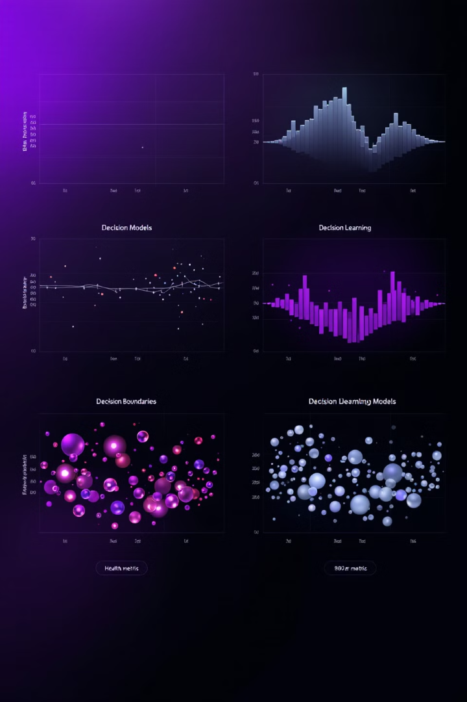
Model Selection and Training
Logistic Regression
Baseline model.
Decision Tree
Simple tree-based model.
Random Forest
Ensemble of decision trees.
XGBoost
Gradient boosting model.

Slide 8




Model Evaluation Metrics
Accuracy
1
Precision
Overall correctness.
2
True positives.
F1 Score
4
Recall
3
Harmonic mean.
Identified positives.

Slide 9
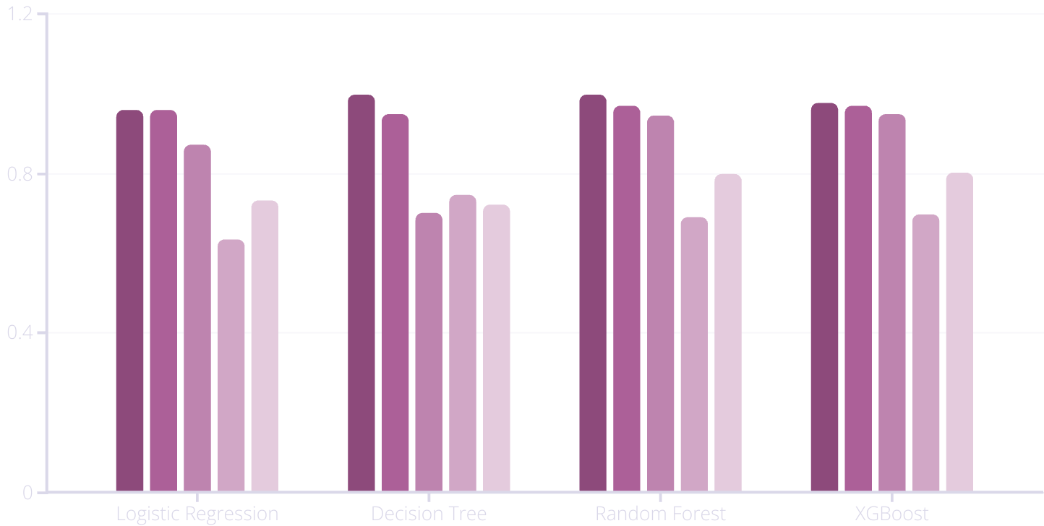
Model Performance Comparison
Train Accuracy
Test Accuracy
Precision
Recall
F1 Score

Slide 10
Key Insights & Next Steps
Prioritize Recall
1
Identify at-risk individuals.
Minimize False Positives
2
Reduce unnecessary actions.
Deploy XGBoost
3
Real-time predictions.

